Slide 1
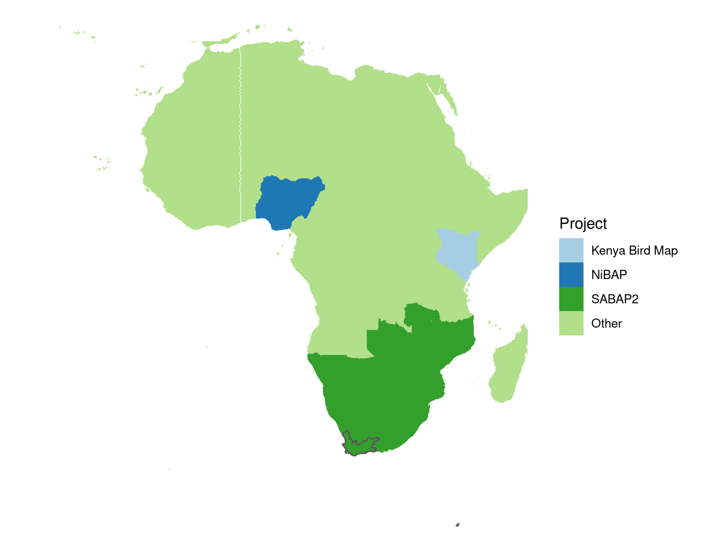
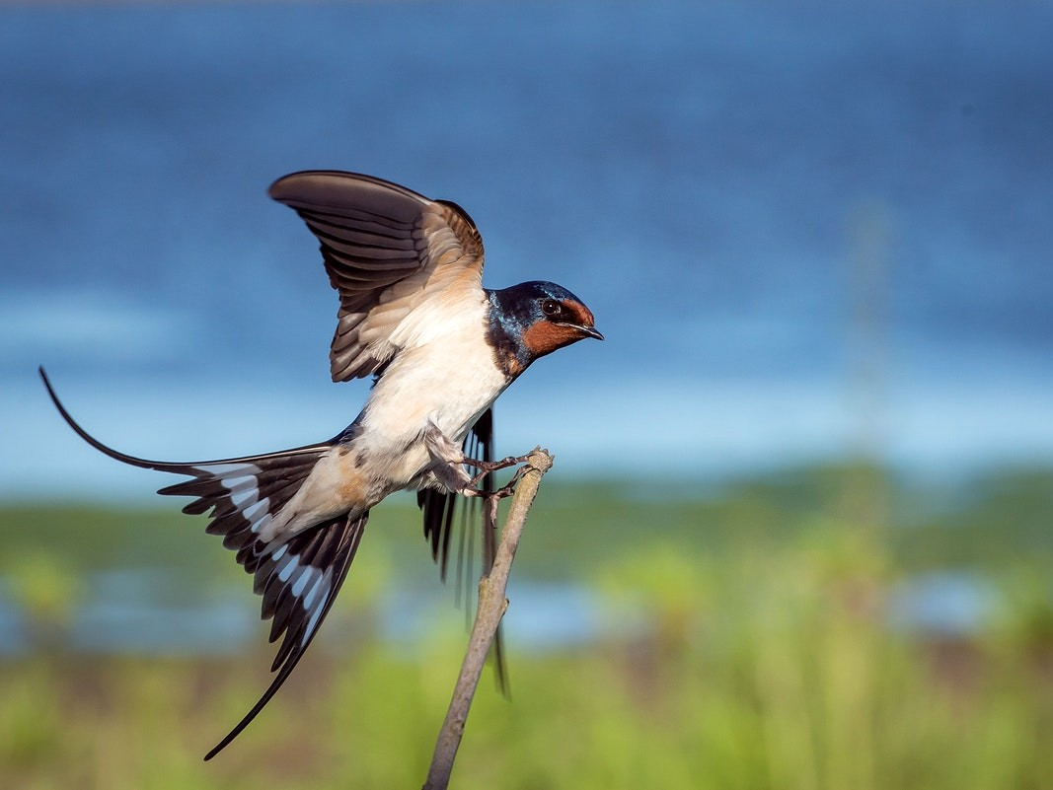
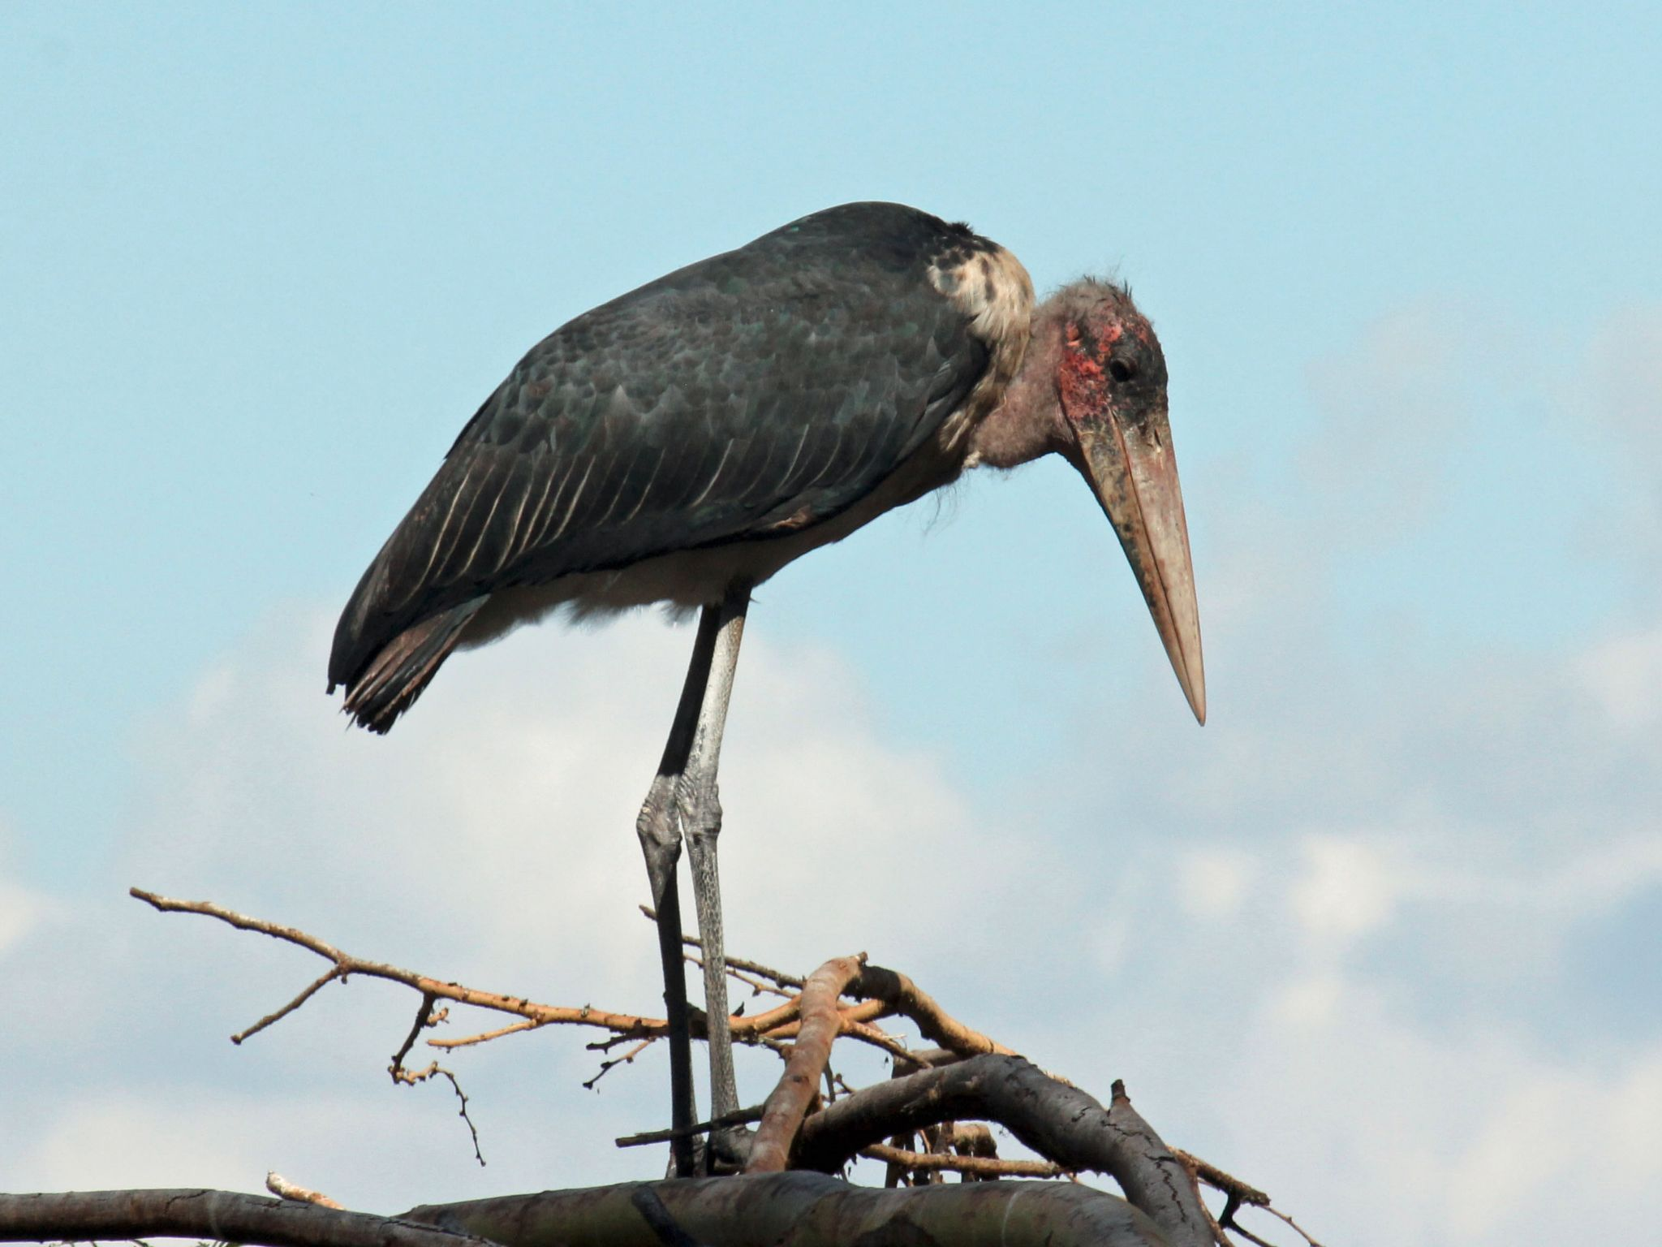
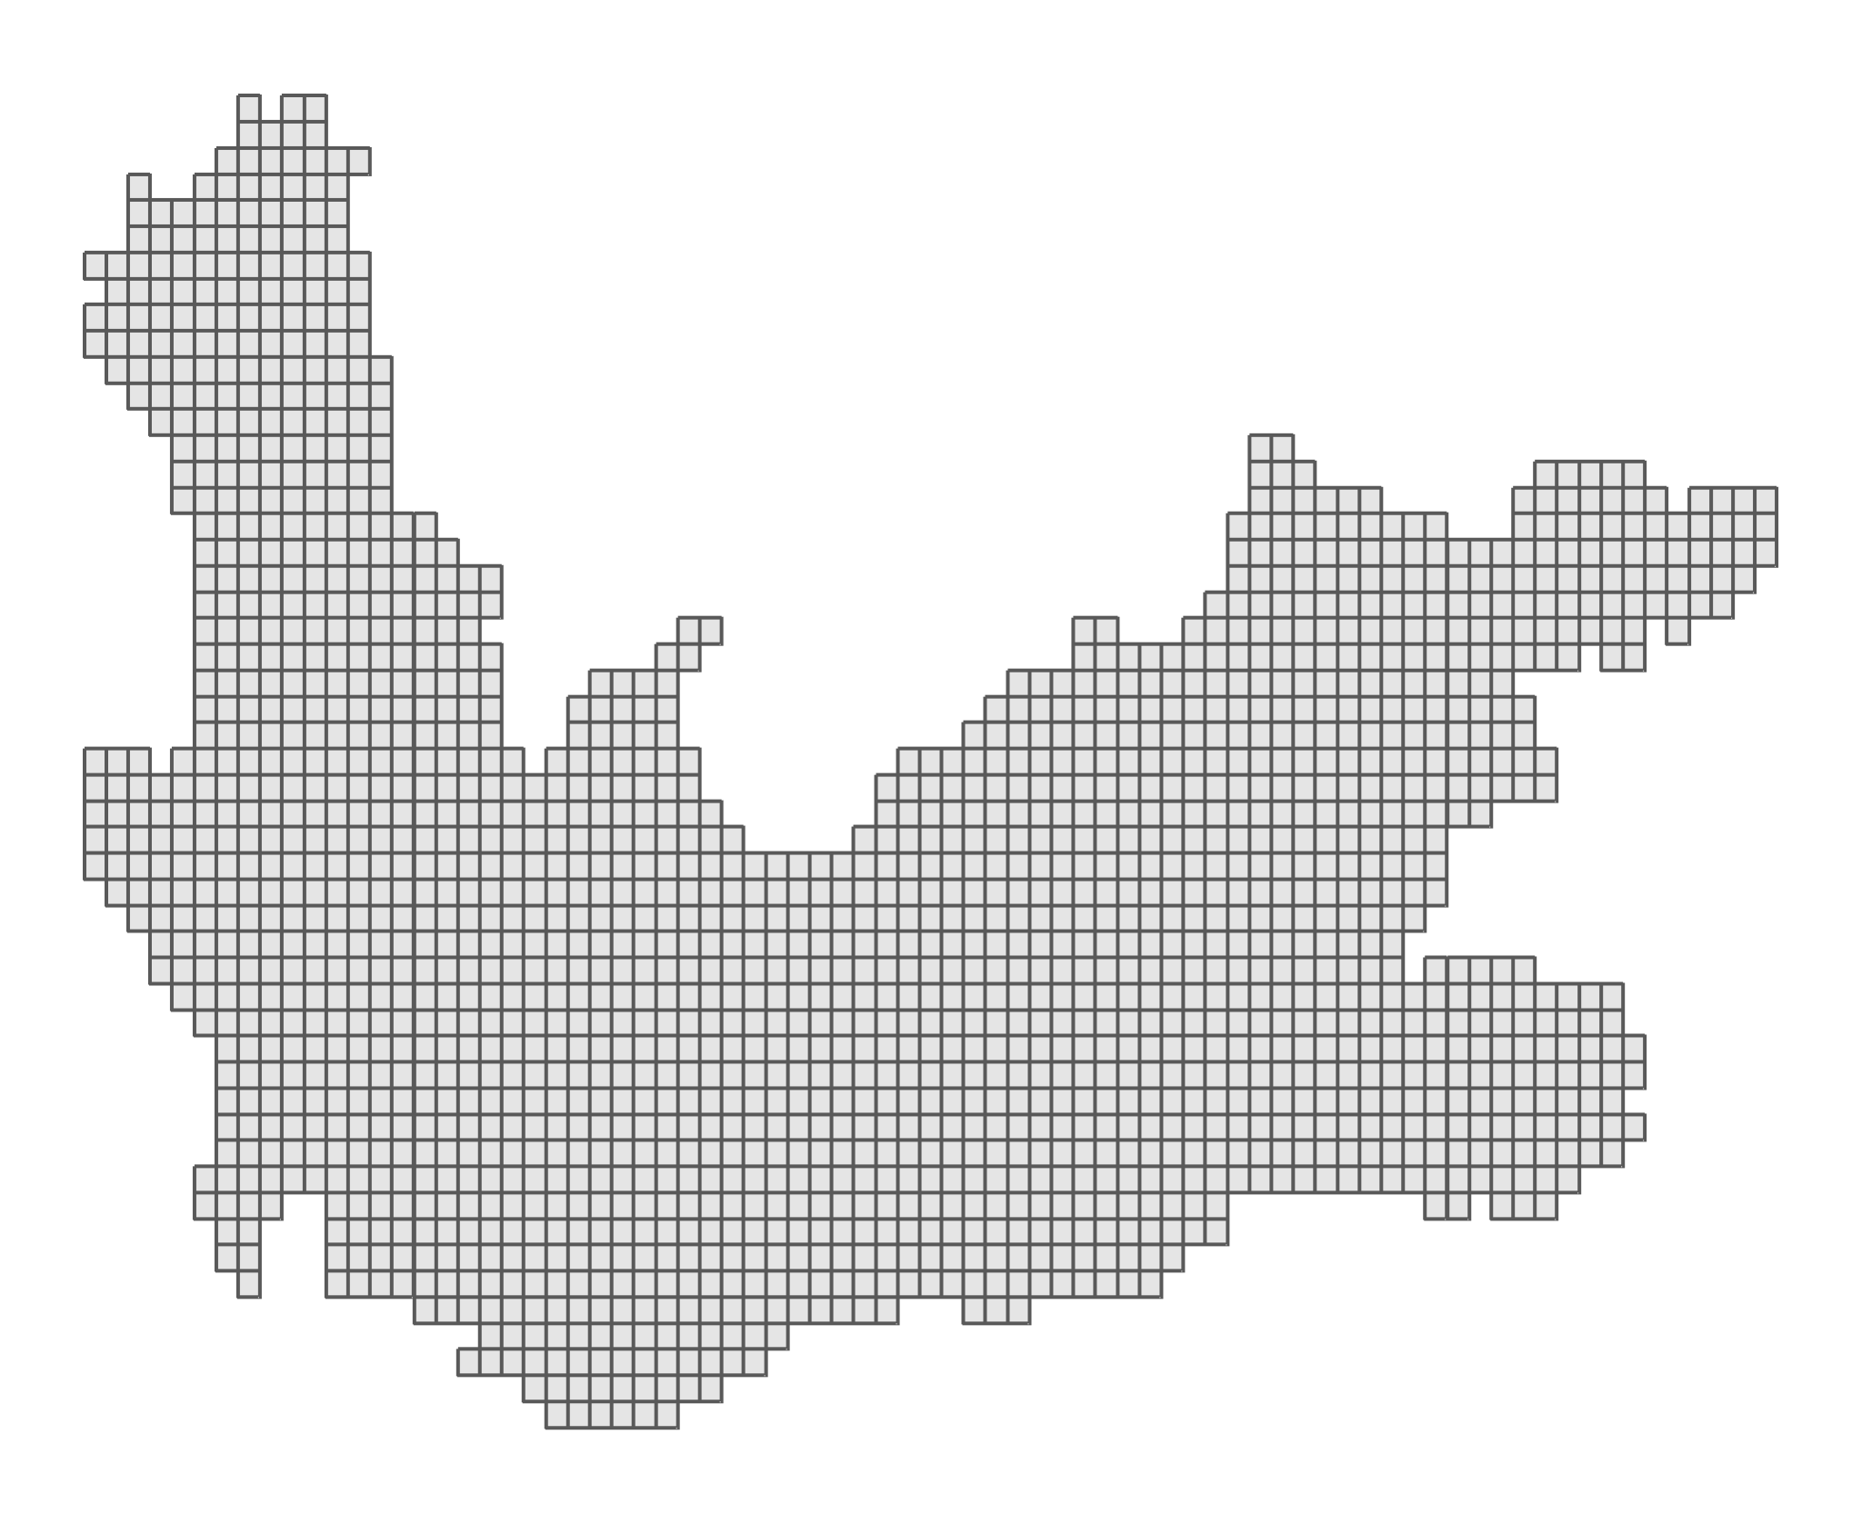
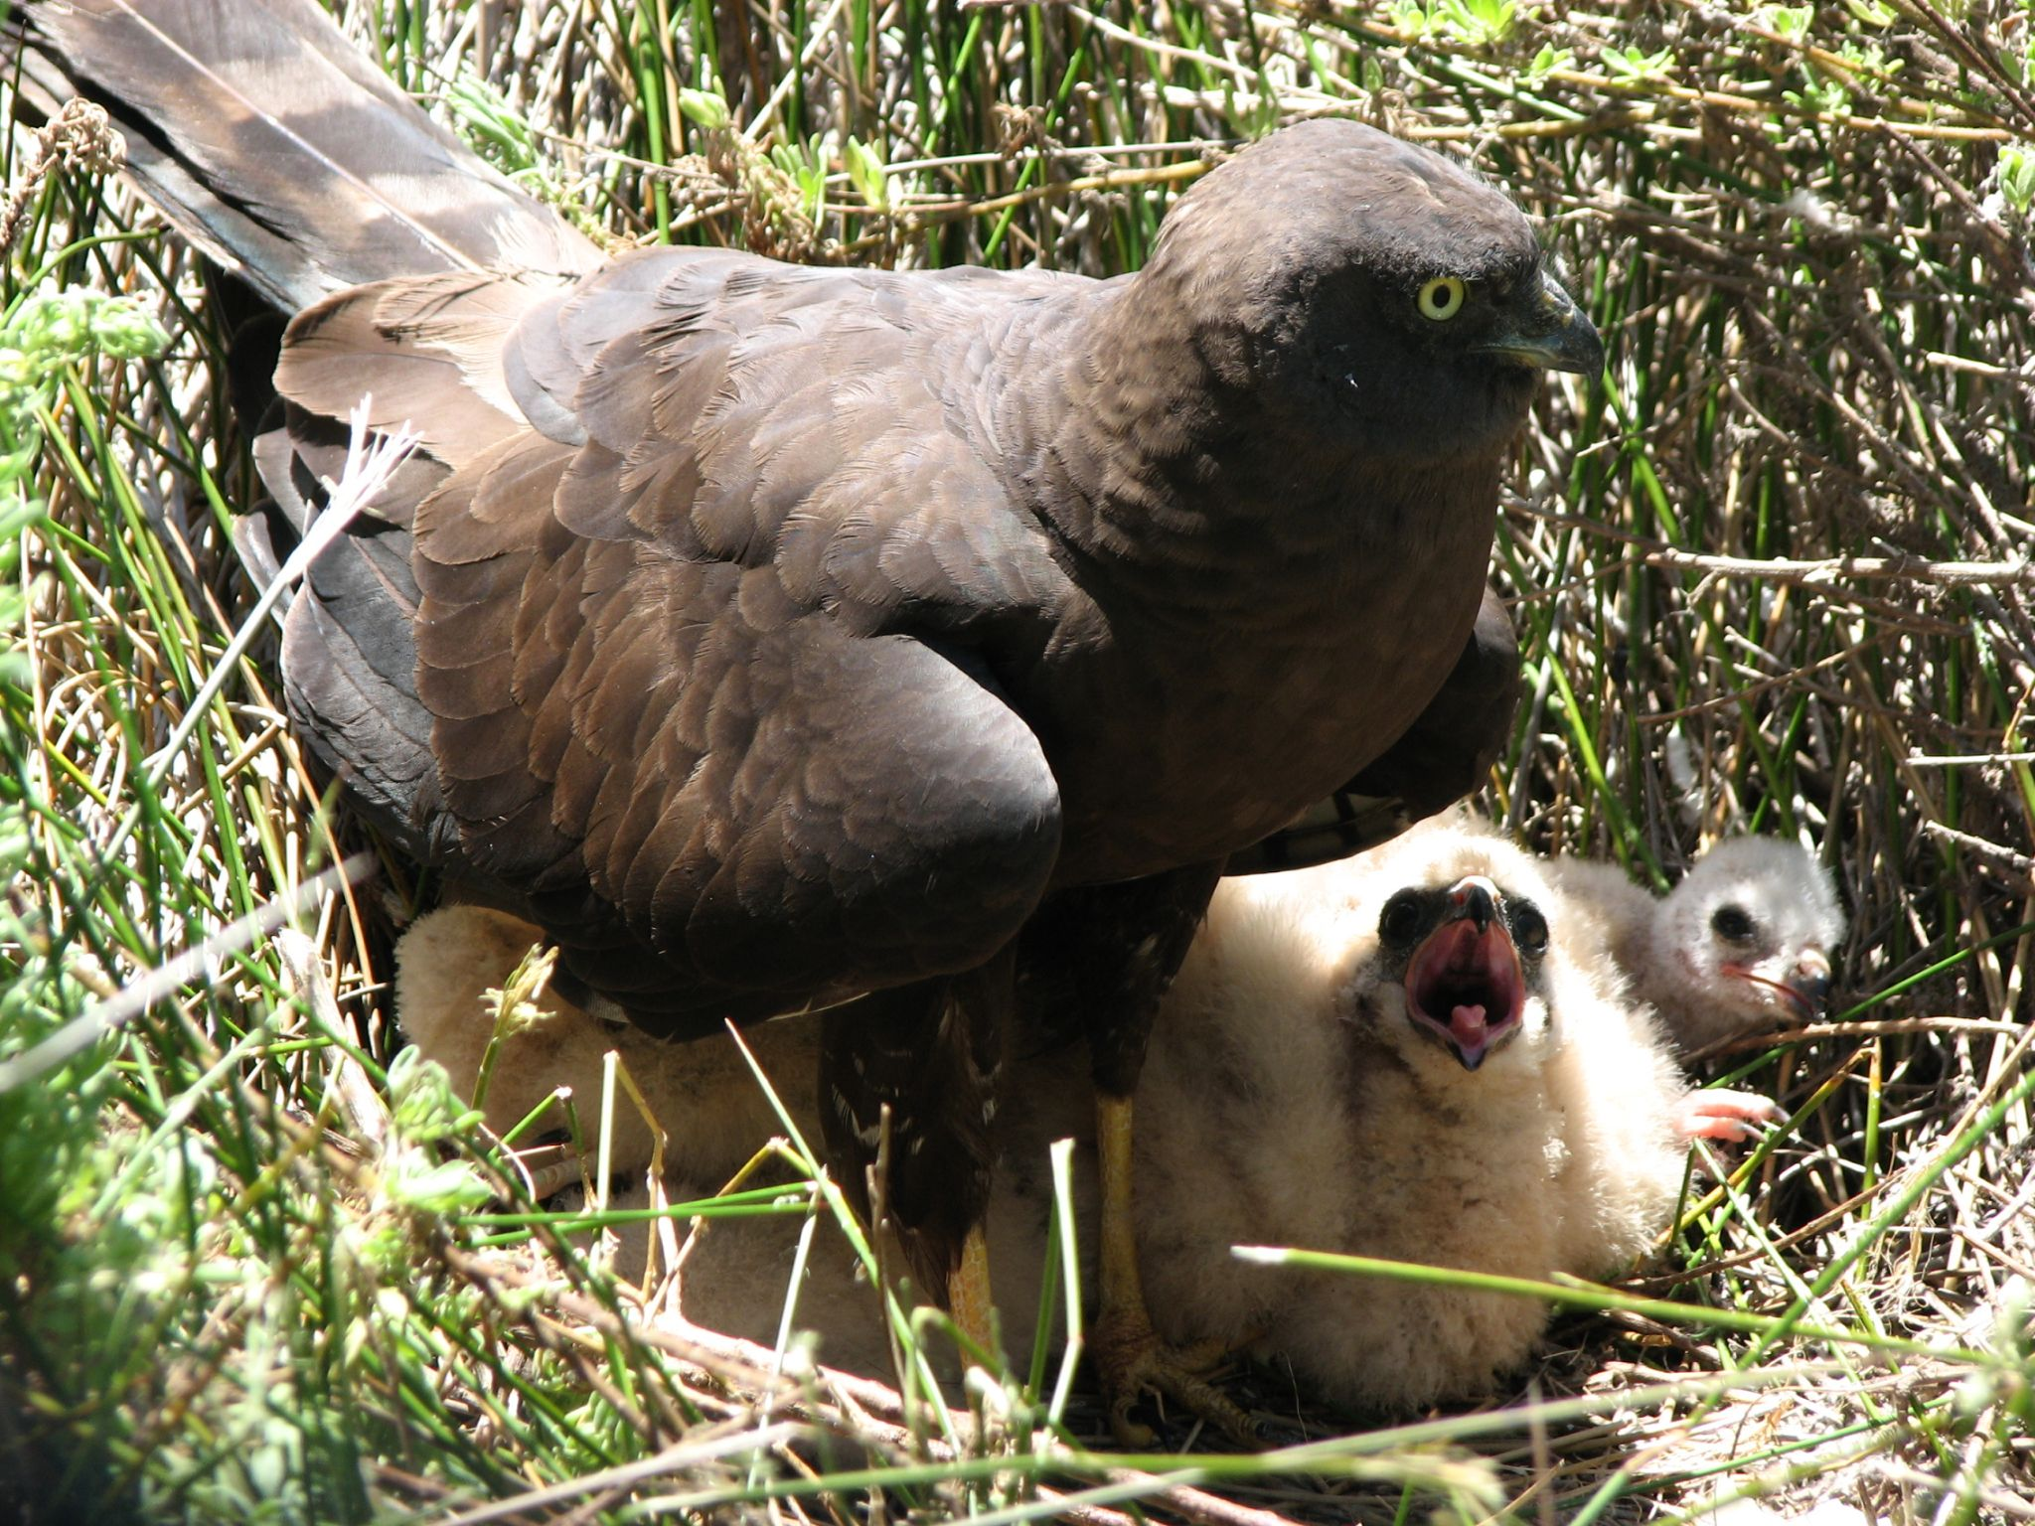

African Bird Atlas Project
ABAP: An R package to access African Bird Atlas Project data
Francisco Cervantes¹, Michael Brooks², Dominic Henry^{1,3}, and Res Altwegg¹
Centre for Statistics in Ecology, the Environment and Conservation, University of Cape Town; ²South African National Biodiversity Institute; ³FitzPatrick Institute of African Ornithology, University of Cape Town; ⁴The Endangered Wildlife Trust. *f.cervantesperalta@gmail.com
A common African protocol
Citizen science
Grid of pentads → 5’ x 5’ cells
Detection/non-detection data
Species distribution
https://github.com/AfricaBirdData/ABAP

Slide 2

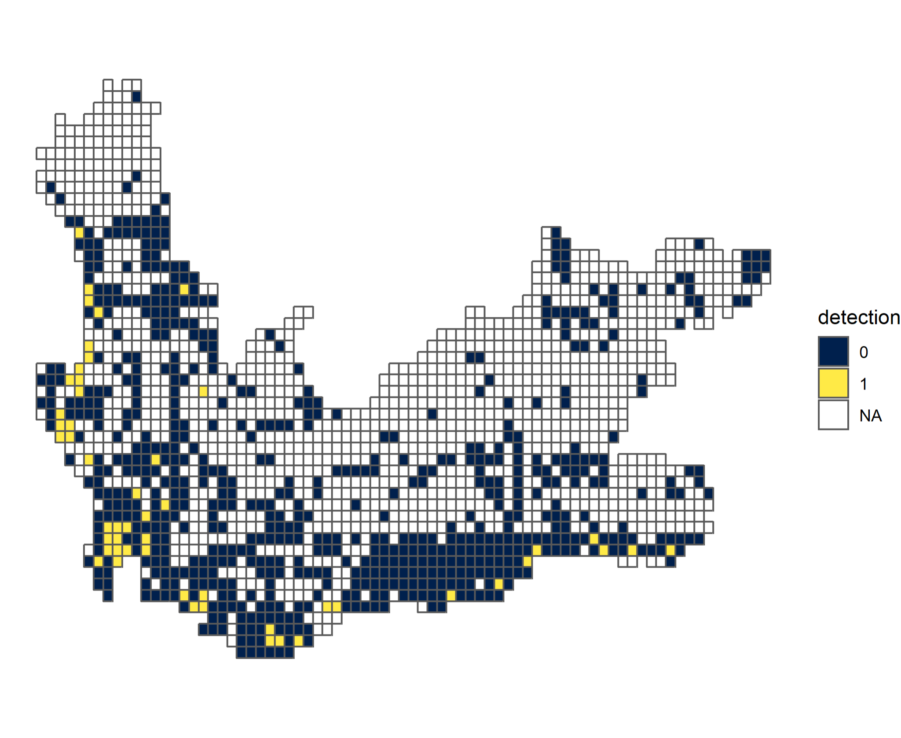
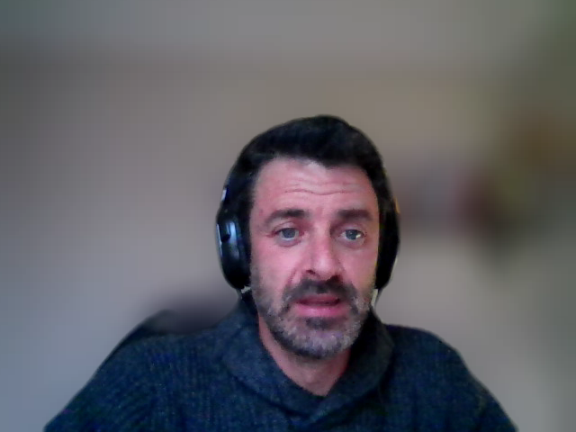
Download detection/non-detection data
ABAP: An R package to access African Bird Atlas Project data
Francisco Cervantes¹, Michael Brooks², Dominic Henry^{1,3}, and Res Altwegg¹
Centre for Statistics in Ecology, the Environment and Conservation, University of Cape Town; ²South African National Biodiversity Institute; ³FitzPatrick Institute of African Ornithology, University of Cape Town; ⁴The Endangered Wildlife Trust. *f.cervantesperalta@gmail.com
Download pentads
(area of interest)
Download detection/non-detection data
getRegionPentads()
getAbapData()
https://github.com/AfricaBirdData/ABAP

Slide 3
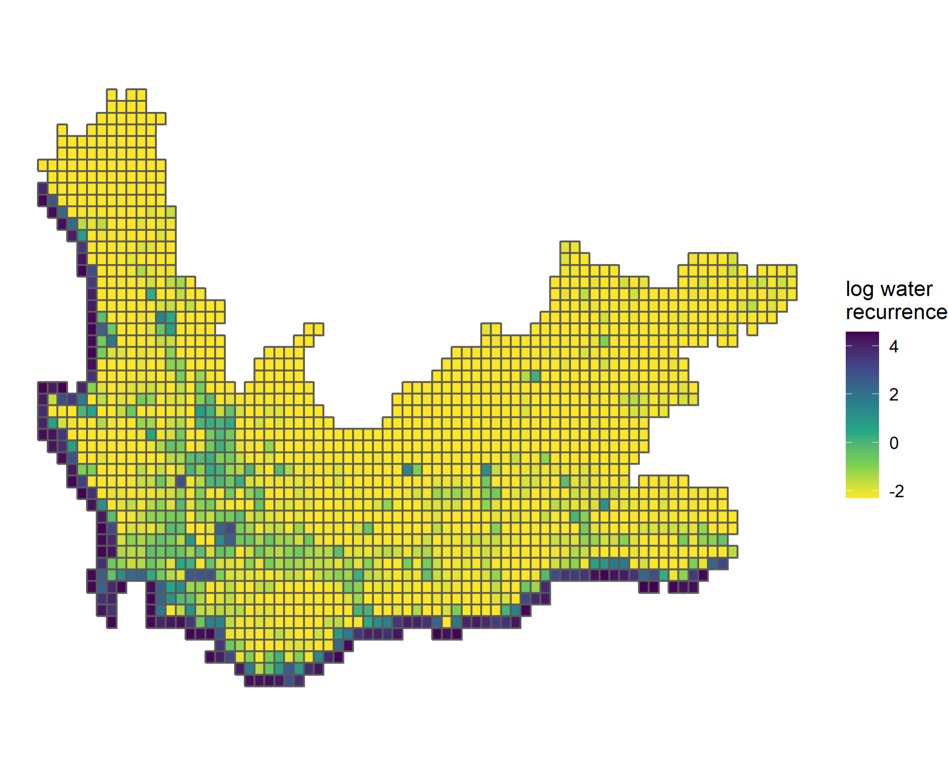
Annotate with environmental data
ABAP: An R package to access African Bird Atlas Project data
Francisco Cervantes¹, Michael Brooks², Dominic Henry^{1,3}, and Res Altwegg¹
Centre for Statistics in Ecology, the Environment and Conservation, University of Cape Town; ²South African National Biodiversity Institute; ³FitzPatrick Institute of African Ornithology, University of Cape Town; ⁴The Endangered Wildlife Trust. *f.cervantesperalta@gmail.com
Download pentads
(area of interest)
Annotate with variables from Google Earth Engine
getRegionPentads()
addVarEEimage()
https://github.com/AfricaBirdData/ABAP

Slide 4
Re-format for occupancy analysis
ABAP: An R package to access African Bird Atlas Project data
Francisco Cervantes¹, Michael Brooks², Dominic Henry^{1,3}, and Res Altwegg¹
Centre for Statistics in Ecology, the Environment and Conservation, University of Cape Town; ²South African National Biodiversity Institute; ³FitzPatrick Institute of African Ornithology, University of Cape Town; ⁴The Endangered Wildlife Trust. *f.cervantesperalta@gmail.com
Re-format for analysis in a variety of R packages
abapTo*()
{unmarked}
{ubms}
{spOccupancy}
…
https://github.com/AfricaBirdData/ABAP

Slide 5
Benefits of ABAP R package
ABAP: An R package to access African Bird Atlas Project data
Francisco Cervantes¹, Michael Brooks², Dominic Henry^{1,3}, and Res Altwegg¹
Centre for Statistics in Ecology, the Environment and Conservation, University of Cape Town; ²South African National Biodiversity Institute; ³FitzPatrick Institute of African Ornithology, University of Cape Town; ⁴The Endangered Wildlife Trust. *f.cervantesperalta@gmail.com
Accessibility
Flexibility
Reproducibility
https://github.com/AfricaBirdData/ABAP

